Slide 1
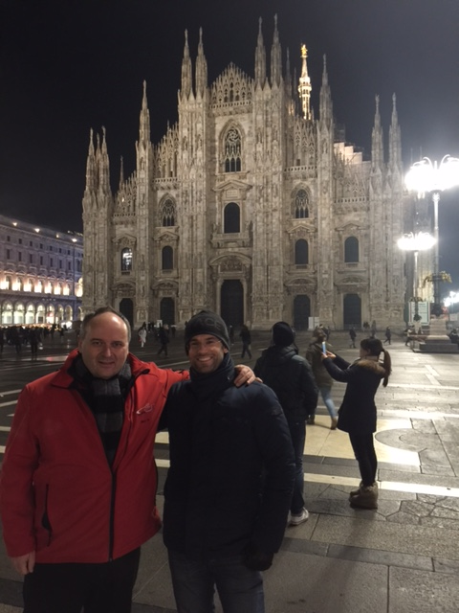
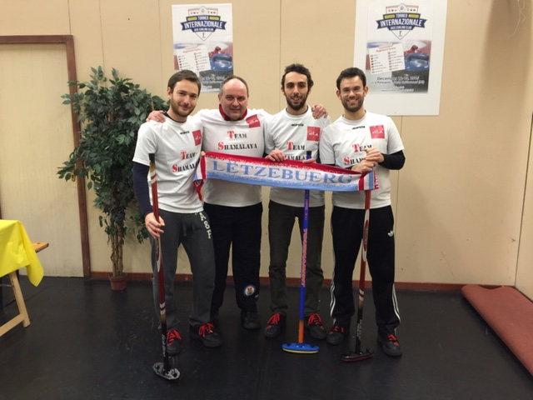
1st International Tournament in Milano, Dec 2015
CCHL was represented at the 1st Jass Milano Curling Tournament by its team Shamalaya that succeeded to achieve an honorable 4th place among 14 teams. Fabio Veltri, Francesco Grassi, Furio Pezzoli & Marc Hansen started badly by loosing the first game against the local team Stonti. The next two games were won against two ladies teams from Lithuania, where they hammered a 12-0 in their 3rd game(being also the highest score in the whole tournament) allowing themselves to reach the closed Semi-finals.
Although battling very hard our Curlers lost twice against Campina and Champéry.

Slide 2
